Slide 1
Course Content Overview
CSCE 623

Slide 2
Learning Outcomes
At the end of the course a student will be able to:
Construct a research question which can be answered using the Machine Learning (ML) pipeline.
Obtain, clean, and wrangle data to prepare it for use with ML algorithms.
Select and apply ML algorithms and use them to fit and tune ML models from data.
Assess results and report findings of ML efforts in a reproducible way

Slide 3
ML Key Topics
End-to-End Machine learning pipelines / Data Science Trajectories
Statistical learning & defining the ML task
Task Types:
Supervised vs. Unsupervised
Regression vs. Classification
Models
Bias-Variance Tradeoff
Linear vs. Nonlinear
Parameterized vs. Non-parametric
Single models vs. Ensemble
Data Wrangling (Preprocessing, Feature Engineering)
Training, Tuning, Residuals Analysis
Testing, Reporting Performance

Slide 4
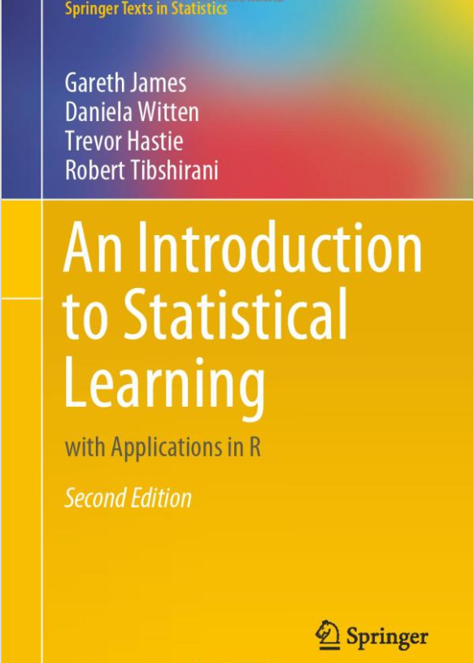
10-Week Roadmap
ROE / Overview / ML Pipelines
Ch 1 / 2 (intro & stat learning overview)
Ch 3 Linear Regression
Ch 4 Classification
Ch 5 Resampling & Validation techniques
Ch 6 Linear Model selection and Regularization
Ch 8 Tree-based methods
Ch 9 Support Vector Machines
Ch 10: Unsupervised learning (PCA & Clustering)
Project Help Session
*not covered… Chapter 7 – Moving Beyond Linearity

